Slide 1

Android Permissions Remystified: A Field Study on Contextual Integrity
Primal Wijesekera , Arjun Baokar, Ashkan Hosseini,
Serge Egelman, David Wagner, Konstantin Beznos

Slide 2

Brief Introduction to Android
Open Source Mobile OS currently owned by Google
Currently on version 6.0(Marshmallow)
Applications can be installed from Google PlayStore
Permissions should be granted for apps to access sensitive resources
Developers required to specify permissions in the Android Manifest using principle of “Least Privilege”
Notes:
-Android is open source mobile OS first developed by independent company Android Inc, acquired by Google in 2005
-Leading mobile OS, competitors: iOS, Windows, Blackberry Symbian (29.1%)
-Versions traditionally named after desserts alphabetically, and current version 6.0 marshmallow(SDK 23) Software Development Kit
-Applications by 3rd parties and Google itself downloadable from Google Play
-Users have to grant permission for apps to access certain resources
-Developers when uploading specify these in Android Manifest (xml file that should be present in root directory. Essential info about app to Android system)

Slide 3
Granting Permission – Upto Android M
Show list of permissions before installation
Accept or Cancel?
Accept Application will be installed. Permission cannot be revoked.
Cancel installation App will not be installed.
Notes:
-In versions of the SDK older than 23, permissions follow a ‘do or die’ model.
-To download an application a user has to choose to install it from the PlayStore
-series of permissions will be shown, and these have to be approved before the download starts.
-Users cannot grant permission selectively, and once granted permission cannot be revoked.
-If a user chooses not to grant a particular permission the installation will be cancelled.
-This of course creates several issues, with the main problem being that users can’t change these permissions later, and there is no explanation as to why an application requires a particular permission.

Slide 4
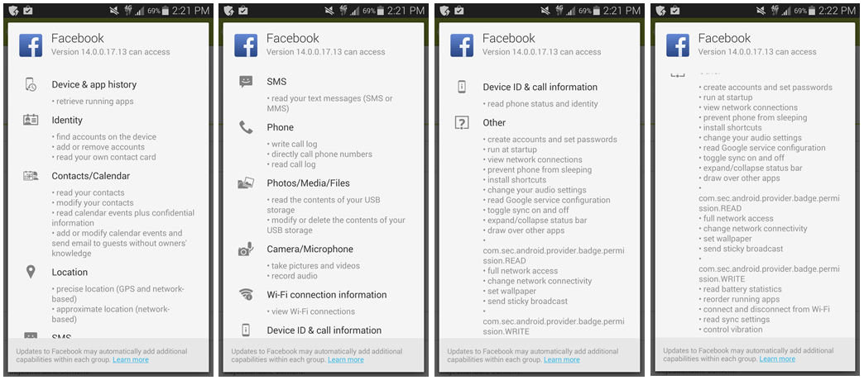
Notes:
This is a screenshot of permissions requested by Facebook, and as you can see a user can’t choose which permissions to grant, even though this includes a LOT of permissions.

Slide 5
Granting Permission- After Marshmallow
Installed application needs to access permission at runtime
“Normal” or “Dangerous”?
Normal Permissions Grant without notifying the user.
Dangerous Permissions
Completely new Popup notification appears requesting for permission
Another permission in the group has already been granted
Grant permission
Notes:
-Several problems with permissions fixed in Android version 6.0; Marshmallow
-Permissions can be granted at runtime, instead of install time and can be reverted later.
-Permissions have been divided into two categories; PERMISSION_NORMAL and PERMISSION_DANGEROUS.
-Normal permissions cover areas where the app needs to access data outside the applications' sandbox, but the risk to user privacy is low as defined by Android.
-These permissions are granted automatically by the application.
-Dangerous permissions on the other hand are further divided into classes.

Slide 6
Normal Permissions [4]
ACCESS_LOCATION_EXTRA_COMMANDS
ACCESS_NETWORK_STATE
ACCESS_NOTIFICATION_POLICY
ACCESS_WIFI_STATE
BLUETOOTH
BLUETOOTH_ADMIN
BROADCAST_STICKY
CHANGE_NETWORK_STATE
MODIFY_AUDIO_SETTINGS
NFC
READ_SYNC_SETTINGS
READ_SYNC_STATS
RECEIVE_BOOT_COMPLETED
REORDER_TASKS
REQUEST_IGNORE_BATTERY_OPTIMIZATIONS
REQUEST_INSTALL_PACKAGES
SET_ALARM
CHANGE_WIFI_MULTICAST_STATE
CHANGE_WIFI_STATE
DISABLE_KEYGUARD
EXPAND_STATUS_BAR
GET_PACKAGE_SIZE
INSTALL_SHORTCUT
INTERNET
KILL_BACKGROUND_PROCESSES
SET_TIME_ZONE
TRANSMIT_IR
UNINSTALL_SHORTCUT
USE_FINGERPRINT
VIBRATE
WAKE_LOCK
WRITE_SYNC_SETTINGS
Notes:
These are a list of permissions classified as “normal”. Risky :
ACCESS_WIFI_STATE CHANGE_NETWORK_STATE INTERNET REORDER_TASKS

Slide 7
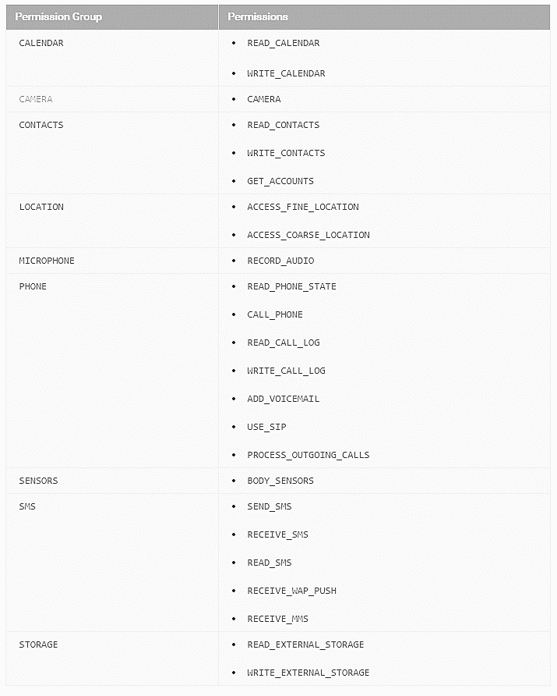
Dangerous Permissions
Notes:
-When a ‘dangerous’ permission is requested if an app does not have any permissions in that group a runtime notification pops up where the user can choose to grant/revoke permission. If another permission in that group has already been granted, the app goes ahead and grants it without notifying the user.
-This is a set of dangerous permissions. As you can see READ_CONTACTS and WRITE_CONTACTS are in the same group. Therefore if an app requests WRITE_CONTACTS permission and READ_CONTACTS has already been granted, it will not notify the user.
Similarly permissions not listed here are classified as ‘Normal and granted automatically. These include:

Slide 8
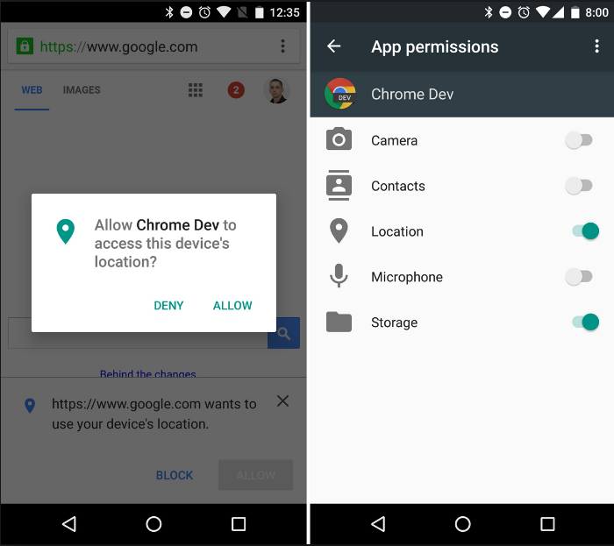
Notes:
This is a screenshot of Android requesting permissions at runtime on a device running Marshmallow. Permissions can be toggled after they have been granted.

Slide 9
Problem

Slide 10
“Contextual Integrity”
Developers:
Given freedom and responsibility
Not well informed
Expected to follow principle of “Least Privilege”
Users:
Not fully knowledgeable
Lack of comprehension
No contextual cues
User habituation
Problem? Personal information used in ways that defy user expectations.
Notes:
Now we come to the main problem highlighted in the paper. Developers are given freedom and responsibility in when uploading apps to PlayStore, unlike iOS, Windows and BB which all have a centralized monitoring process before uploading apps. They’re supposed to follow principle of least privilege. Results in permission creep. Users not knowledgeable about privacy, and lack contextual cues to understand how privacy applies in a particular situation. Another problem is habituation-which is basically something like doing something out of habit e.g. License agreement. So main problem here is that this personal information can be granted in ways that defy user expectations. So the concept of “privacy as contextual integrity” can be applied to smartphone permission systems to yield more effective permissions by only prompting users when an application’s access to sensitive data is likely to defy expectations

Slide 11
Related Work -Studies
Improvements to the model-hierarchical and structural changes
Providing users with more information helps with the choice
Identifying malicious apps through permission requests or NLP
Static analysis tools to analyze permission specifications
Recommending apps based on security concerns
Dynamically block runtime requests
AppFence- provide fake data to applications
User expectations surrounding permissions examined, mapping permission to API calls – “Android Permissions Demystified”
Notes:
Some of the related work in this field has been analyzed. Basically there is a lot of research for malware detection, recommending apps and even feeding fake data to apps in place of privacy sensitive information. One of these-the paper where user expectations surrounding permissions examined is by Adrienne Porter Felt, a security researcher at Google Chrome who has developed a tool called STOWAWAY which maps API calls to permissions and called “Android Permissions Demystified”, hence the name of this paper.

Slide 12
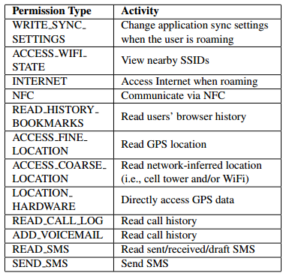
Felt et al. – “How to ask for permission”
When to prompt? When permission requests are unexpected, irreversible, sensitive, costly
Conclusion? 84% of Android permissions can be automatically granted
Confront users with necessary permission requests, not the expected, reversible, or unconcerning ones.
Notes:
Reducing the number of decisions decreases habituation
Output- decision tree to determine most appropriate permission-granting mechanism
Conclusion- majority of Android permissions can be automatically granted
Interestingly in Android M, the top four are NORMAL permissions and granted automatically.

Slide 13
Methodology

Slide 14

Methodology
Step 1: Collect as much data as possible about access to protected resources, while minimizing impact on performance
Step 2: Survey users when they exit the experiment
Notes:
How often and under what circumstances smartphone apps are accessing protected resources regulated by permissions? If given the opportunity would users deny permission requests?

Slide 15
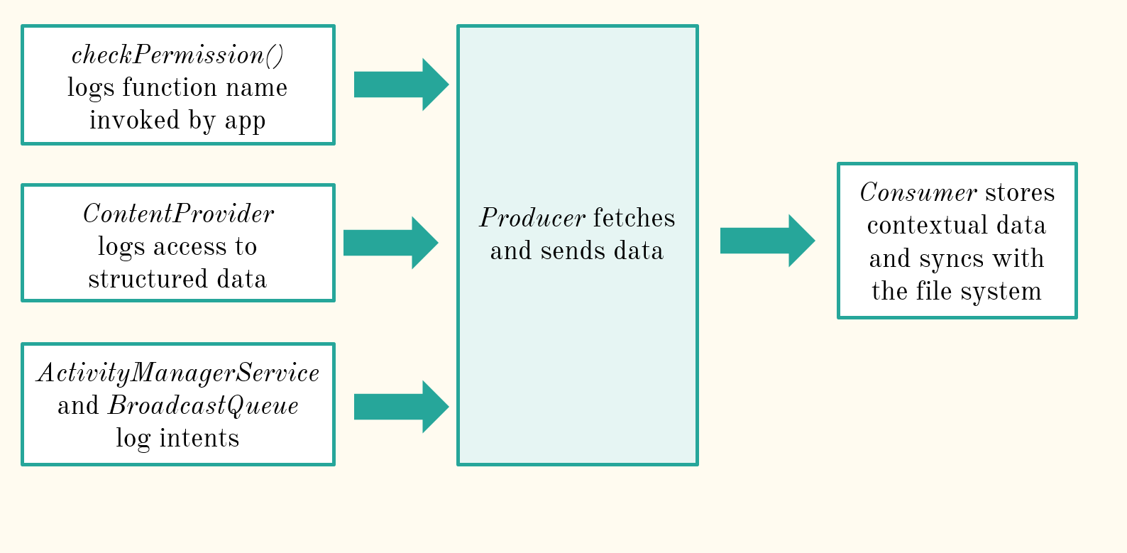
Logging Data
Notes:
Android platform has been modified to add a logging framework to determine every time a resource is accessed by an app at runtime. Target device- Samsung Nexus S, Android 4.1.1 –Jellybean used.
checkPermission logs function name ContentProvider class protects structured data such as calendar and contacts so it can be used to log this type of data access
Other logs INTENTS- using another apps permissions. E.g. Opening a url received through sms on your browser.

Slide 16
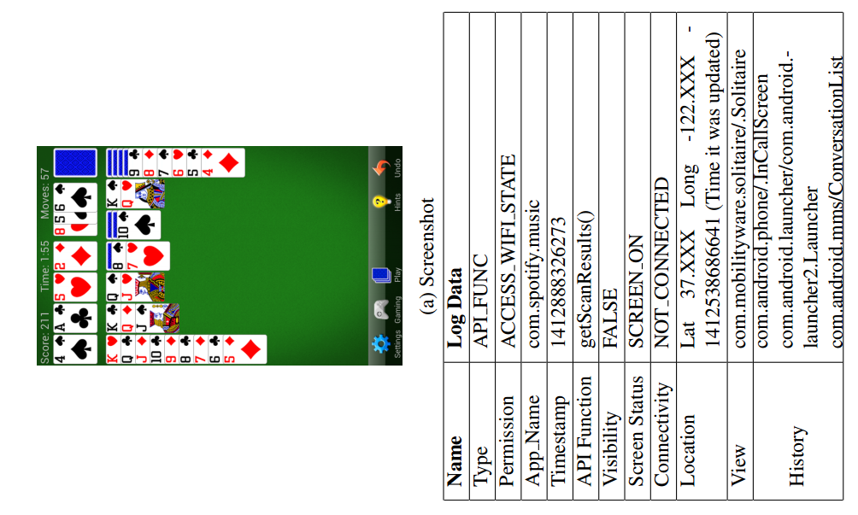
Output
Name of the permission
Name of the application
API method that resulted in the check
Screenshot while permission request was taking place

Slide 17
Data Collection Procedure
Recruitment - Craigslist advertisement - 36/48 selected - 19 male and 17 female - Ages 20 to 63
1 week of real world use
27 million permission requests (107,142 requests per day per user)

Slide 18
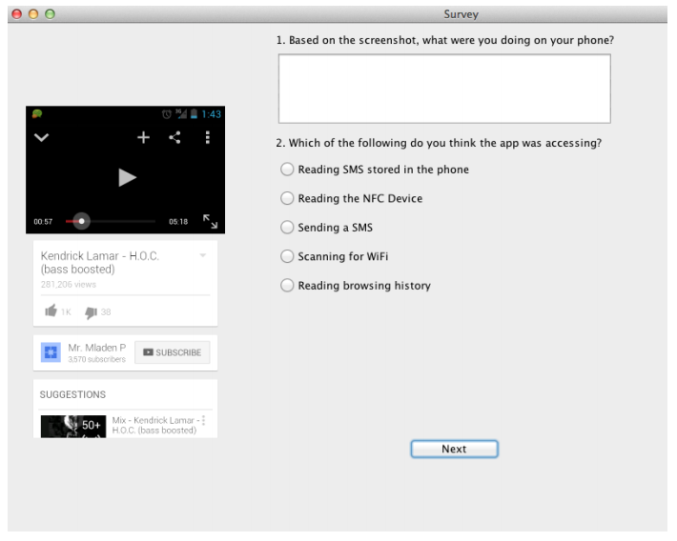
Exit Survey
Whether resource access instances are expected
Whether users would like to deny access
Notes:
The users who returned their phones were then taken to a room and given a survey to answer. Here they’ve asked what the user was doing based on a screenshot shown, which permission the user expected was being accessed,

Slide 19
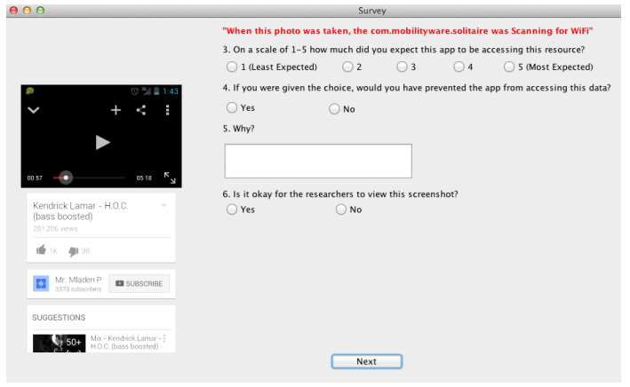
Notes:
Then they’ve told the user what app was ACTUALLY accessing which permission and asked whether this was expected behavior. Then to overcome the ethical perspective they’ve asked whether the respondant would be ok with the researcher accessing this screenshot.

Slide 20
Findings and Analysis

Slide 21
Application Behavior – Invisible Permission Requests
75.1% Invisible
Notes:
Now we come to the findings. This is a pie chart of the data given in the paper to highlight invisible permission requests. EXPLAIN pie chart. And when you remove the visible instances, it can be see that more than 75% of requests are invisible.
However the 60% of requests that happened while the screen was off maybe biased because another paper by Harbach has suggested that screens are off 94% of the time. So this actually suggests that permission requests occurred less frequently than when participants were using their phones.

Slide 22
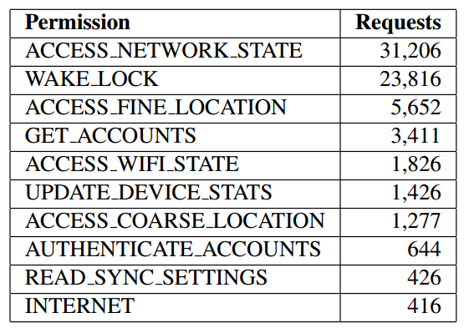
Most Frequently Requested ‘Invisible’ Permissions
Stored SMS messages 125 times/user/day
Browser history 5 times/user/day
Camera once/user/day
Notes:
Now to facilitate contextual integrity, information flows should be determined by the user. Recent versions of Android allow users to see which applications have used location data recently. While attribution is a positive step towards contextual integrity, attribution is most beneficial for actions that are reversible, whereas the disclosure of location information is not something that can be undone->IRREVERSIBLE.
Apart from these invisible location requests, we also observed applications reading stored SMS messages (125 times per user/day), reading browser history (5 times per user/day), and accessing the camera (once per user/day)

Slide 23

Location Requests- Breakdown
Telephony Manager – 66.1%
SSID of wifi network – 33.3%
Built-in location providers – 0.6% - GPS – 6% - Network provider – 13% - Passive location provider – 81%
Notes:
Generally we tend to think that location can only be accessed when the GPS indicator is turned on. However breakdown of location accesses shows that this only happens 0.6% of the time. The rest of location requests happen through TelephonyManager- logs cellular tower info And WIFI ssid- location based on wifi network
In the remaining 0.6% accessed location information using one of three built-in location providers:
GPS, network, or passive.
Applications accessed the GPS location provider only 6% of the time (which displayed a GPS notification).
In the other 94% of the time, 13% queried the network provider (i.e., approximate location based on nearby cellular towers and WiFi SSIDs) and 81% queried the passive location provider.

Slide 24

Application Behavior – High Frequency Requests
With the exception of apps developed by Google, all other apps make excessive requests for phone’s connectivity state Facebook requests ACCESS_NETWORK_STATE permission 5 times per second!
Adverse effect on performance and battery life
Notes:
Except for apps developed by Google themselves, the rest of them made excessive requests for phone connectivity state. In fact in this research they show that fb requests for the ACCESS_NETWORK_STATE permission 5 times per second. Obviously this can have a negative impact on battery life and performance.

Slide 25
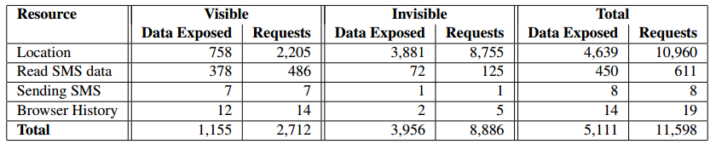
Application Behavior – Frequency of Data Exposure
Observations: - 8 requests per minute/user - 4 exposes per minute/user (15 seconds)
50% of all permission checks granted applications access to sensitive data
Frequency is too high to prompt users in runtime
Notes:
Another finding is the frequency of data exposure.
This table shows the requests breakdown. Explain a line.
Sensitive permission requests (per user/day) when apps visible/invisible to users
So bottom line is that 50% of permission checks grants apps access to sensitive data. Frequency is too high to prompt in runtime.

Slide 26
User Expectations and Reactions
Given screenshots and permission requested, users wanted to block 35% of 432 permission requests
Notes:
Screenshots + permission requested: users want to block 35% of 432 permission request
53% of denied permissions are perceived as functionally irrelevant
“It wasn’t doing anything that needed my current location”
“I don’t understand why this app would do anything
with SMS.”
32% of denied permissions are privacy sensitive
“SMS messages are quite personal”
“It is part of a personal conversation.”
“Pictures could be very private and I wouldn’t like
for anybody to have access.

Slide 27
Influential Factors
Identifying permissions based on blocking Identification of the requested permission based on the screenshot showed no correlation to frequency of blocking
Visibility of the application Users block applications which request permission when not visible
Privacy preferences No correlation between privacy preferences and desire to block permission requests
Expectations Users tend to want to block requests that are not expected
Notes:
Effects of identifying permissions on blocking What they’ve done here is to try to identify whether users who blocked applications more were more aware of the reasons an app used the permission or not, and they’ve found no correlation between users blocking apps and correctly guessing the permission.
Privacy preferences
This is somewhat surprising.. They’ve compared results of two scales Internet users information privacy concerns scale and privacy concerns scale and found that there’s no correlation between their privacy preferences and how they block requests.
Privacy Concerns Scale Internet Users’ Information Privacy ConcernsA Spearman’s rank test yielded no statistically significant correlation between their privacy preferences and their desire to block permission requests

Slide 28
Feasibility of Runtime Prompts
Runtime prompts for 12 permissions highlighted by Felt
Naïve scheme- Once for each triad of app,permission,visibility
34 avg requests
Only if sensitive data will be exposed
29 avg requests
Notes:
So out of this 29, once you remove the requests that occur while the screen is off, 78% of requests are for location. Since iOS already queries a user on the first location access of an app they conclude that this is acceptable since no one has proved that it causes habituation etc. When location is also removed the rest of the requests are only upto 3 per day, which might be somewhat acceptable.
It is not clear how to handle prompts when the user is not available to respond to the prompt: attribution might be helpful, but further research is needed

Slide 29
Modelling
Notes:
Then we come to the statistical modelling which is more complicated than the rest of the paper.

Slide 30
Modelling Users’ Decisions
Use contextual data to model users’ desire to block certain permission requests based on: -Permission type - Requesting function - Visibility of the application
Classifier to determine when to prompt users or to grant permission without user intervention
Notes:
So they’ve used that data to model users desire to block certain permission requests based on these three factors. And find some classifier to determine when to prompt users or grant permission without user intervention.

Slide 31
Mixed Effect Binary Logistic Regression Model
Fixed effects: - Permission type - Visibility of the requesting application
Random effects: -Application name - Participant ID
Notes:
They’ve chosen a binary logistic regression model-which basically means that the dependent variable is categorical and estimates the probability of a given characteristic given the value of explanatory variables
Fixed effects because all possible values for each variable existed in our data set
Random effects because they’re not all present

Slide 32
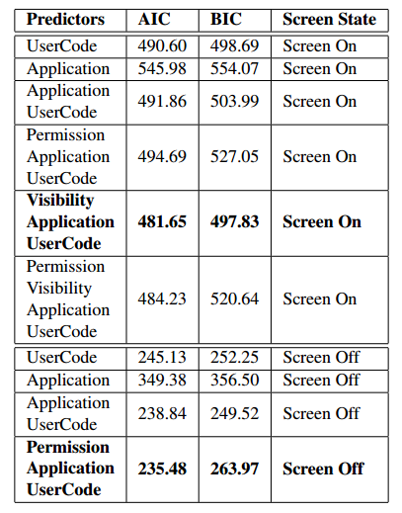
Model selection
Two separate models based on the screen state result in better fit than a single model with screen state as a fixed effect
Notes:
The table shows Goodness-of-fit metrics for various mixed effects logistic regression models on data collected from the exit survey. These measure relative quality of statistical models for the given set of data.
The Akaike information criterion (AIC) is a measure of the relative quality of statistical models for a given set of data. Given a collection of models for the data, AIC estimates the quality of each model, relative to each of the other models.
In statistics, the Bayesian information criterion (BIC) or Schwarz criterion (also SBC, SBIC) is a criterion for model selection among a finite set of models; the model with the lowest BIC is preferred. It is based, in part, on the likelihood function and it is closely related to the Akaike information criterion (AIC).

Slide 33
Predicting User Reactions
Receiver Operating Characteristics(ROC) user to capture tradeoff between true-positive and false-positive rates
Regression model: Screen on: visibility, application, user Screen off: permission, application, user
Different users have different policies. Privacy is subjective
Any classifier developed to automatically decide whether to block a permission at runtime (or prompt the user) will need to be tailored to that particular user’s needs.
Notes:
Receiver Operating Characteristics or ROC curve has been used to measure performance of the binary logistic regression model when it’s discrimination threshold is changed. You can plot TPR against FPR at various settings to determine the best fit.
So the results they’ve reached is that when the screen was on best fit was a model including visibility, name. Fit has been improved once permission type was removed which shows that the decision to block a permission request was based on contextual factors: users do not categorically deny permission requests based solely on the type of resource being accessed (i.e., they also account for their trust in the application, as well as whether they happened to be actively using it).
When the screen was off, however, the effect of permission type was relatively stronger. The strong subject effect in both models indicates that these decisions vary from one user to the next. As a result, any classifier developed to automatically decide whether to block a permission at runtime (or prompt the user) will need to be tailored to that particular user’s needs.

Slide 34
Conclusion
Summary: a field study to quantify the permission usage by third party applications in real-world usage
Findings: - Participants wanted to block access to protected resources 33% of the time. - Visibility of the requesting application and the frequency at which requests occur are two factors which need to be taken into account in designing a runtime consent platform.
Model users’ decisions and investigate how a runtime classifier may be able to determine when to confront users with permission decisions.
Notes:
A first field study to quantify the permission usage by third party applications under realistic circumstances.
Show that participants want to block access to protected resources a third of time.
Model users’ decisions and show how a runtime classifier may be able to determine when to confront users with permission decisions.
showing the circumstances in which Android permission
requests are made under real-world usage

Slide 35
Thank You!
Notes:
Nissenbaum’s theory-39 pages Helen Nissenbaum, Washington Law Review –situational honesty
Resevoir sampling algorithm - randomly choosing a sample of k items from a list S containing n items, where n is either a very large or unknown numbe

